Slide 1
Section 2: What Do I Want?
Lifestyles of the
Satisfied and Content

Slide 2
What Do I Want Now?
To paraphrase Mick Jagger, “You can’t get what you want ‘till you get what you need.”
The psychologist Abraham Maslow developed what has come to be called the Maslow Triangle.
It graphically illustrates the hierarchy of human needs.

Slide 3
Welcome to Chapter 3!
Ch. 3 Dane Blanton Video
Notes:
http://www.careerchoices.com/lounge/cupboard_videos.html

Slide 4
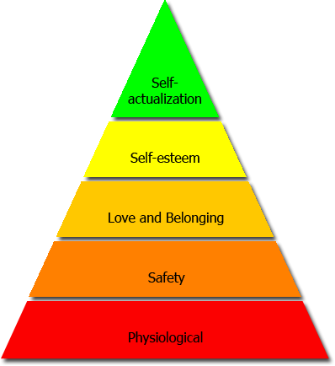
Maslow’s Triangle

Slide 5
First Need: Physiological. In other words. . . Survival!
We must have food, water, clothing, and shelter.

Slide 6
Second Need: Safety and Security
The first two levels deal only with physical and emotional survival.
If a person is at either of these levels, it’s not a satisfying way to live life.
They are struggling to survive… only living for basic survival.

Slide 7
Third Need: A Sense of Belonging
A need to feel connected to others.
Dependent upon people.

Slide 8
Fourth Need: Esteem
We want others to feel that we are worthy of respect.
We also want to respect ourselves.
Thinking about what we want rather than what we need.

Slide 9
Fifth Need: Self Actualization
People who have done what they set out to accomplish, who have reached their goals.
Not many reach this point, and not everyone stays there.

Slide 10
Activity 59
Life Satisfaction is a process!

